Slide 1



Junior Interface Developer
Modulo 02 - Asp.net MVC e Web Api
Da Martedì 27/09/2016 a Giovedì 29/09/2016
Gabriele Gaggi

Slide 2
Asp.net MVC e Web Api
Introduzione allo sviluppo web
Introduzione a ASP.NET MVC5
Progettare applicazioni web in ASP.NET MVC 5
Sviluppare i modelli di ASP.NET MVC 5
Sviluppare i controlli di ASP.NET MVC 5
Sviluppare le viste di ASP.NET MVC 5
Il controllo degli accessi in un’applicazione ASP.NET MVC 5
Creare e consumare servizi ASP.NET Web API

Slide 3
Introduzione allo sviluppo web
Breve storia del Web
Il protocollo http
Il protocollo https
Applicazioni client server
Il modello web standard
Html, CSS e Javascript

Slide 4

Internet

Slide 5
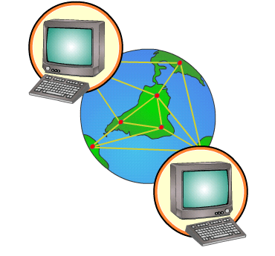
Internet
1991 – Definizione protocollo HTTP 1
1993 – Il CERN rende pubblica la tecnologia
1993 –Mosaic, il primo browser internet
1993 – Nasce Internet Explorer
1994 – Nasce Netscape Navigator ed ha il predominio fino al 1998
1995 : 2000 - Il web si diffonde
1997 – Lancio di Google Search
2004 – Nasce il Web 2.0 con flickr, myspace e youtube

Slide 6
Internet
1991 – Definizione protocollo HTTP 1
1995 – HTML 2.0
1996 – Prima release di Javascript in Netscape Navigator 2.0 e di CSS 1
1997 – HTML 3.2. Microsoft introduce il concetto di DHTML con IE 4
1998 – HTML 4.0, XML 1.0 e CSS 2
1999 – HTTP 1.1 e HTML 4.01. Microsoft crea l’oggetto XMLHttpRequest
2000 – XHTML 1.0
2001 – XHTML 1.1 e nasce JSON
2004 – CSS 2.1 viene candidata a «raccomandation»
2005 – JSON viene rilasciato al pubblico e viene coniato il termine AJAX
2010 – Apple decreta la morte di Adobe Flash e la vittoria di HTML5
2011 – CSS 2.1 diventa «raccomandation»
2012 – CSS 3 diventa «raccomandation»
2014 – HTML5 diventa standard
2015 – HTTP 2.0

Slide 7
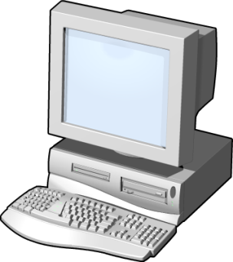
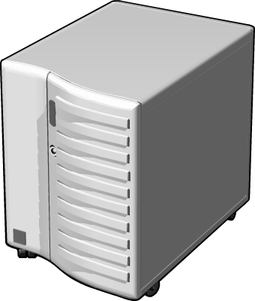


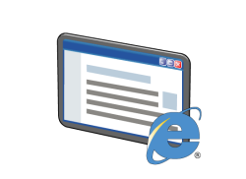

Hypertext Transfer Protocol (HTTP)
Protocollo di tipo Request-Response
Protocollo Stateless
Metodi: GET, POST, PUT, DELETE, etc.
Status code: 1xx, 2xx, 3xx, 4xx, 5xx
https://en.wikipedia.org/wiki/List_of_HTTP_status_codes
Request
Response
Client
Server

Slide 8
Hypertext Transfer Protocol (HTTP)
Server response
HTTP/1.1 200 OK
Date: Mon, 23 May 2005 22:38:34 GMT
Server: Apache/1.3.3.7 (Unix) (Red-Hat/Linux)
Last-Modified: Wed, 08 Jan 2003 23:11:55 GMT
ETag: "3f80f-1b6-3e1cb03b«
Content-Type: text/html; charset=UTF-8
Content-Length: 138
Accept-Ranges: bytes
Connection: close
<html>
<head> <title>An Example Page</title></head>
<body> Hello World, this is a very simple HTML document.
</body> </html>
Client request
GET /index.html HTTP/1.1
Host: www.example.com

Slide 9
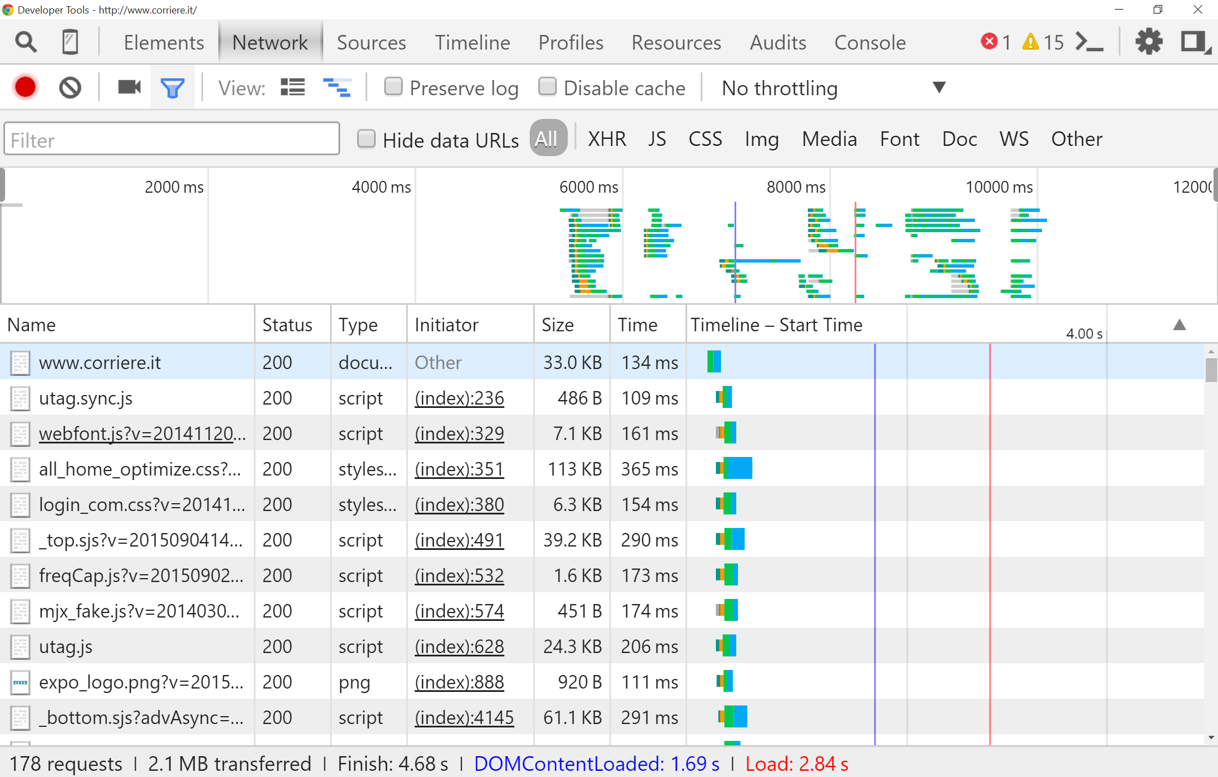
Hypertext Transfer Protocol (HTTP)

Slide 10
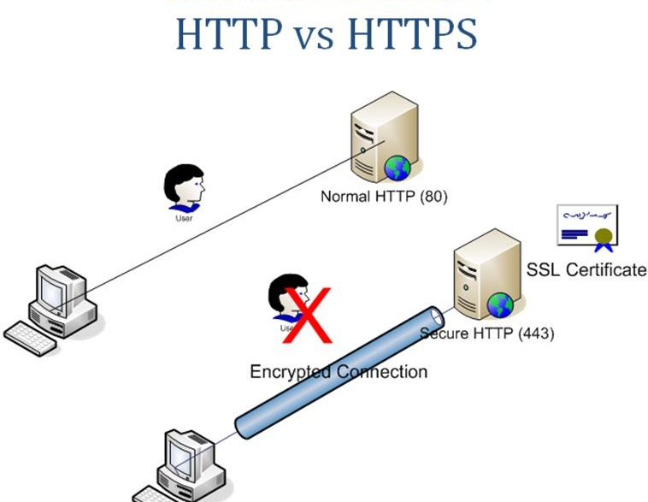

Slide 11
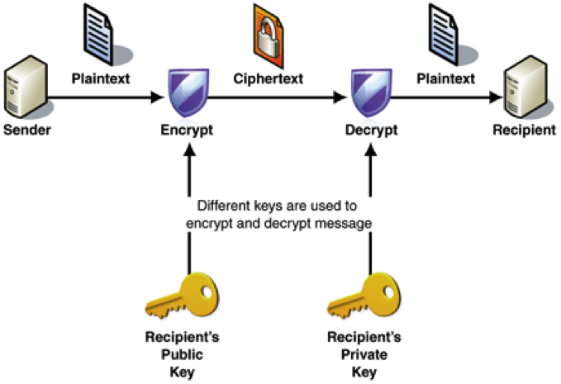

Slide 12
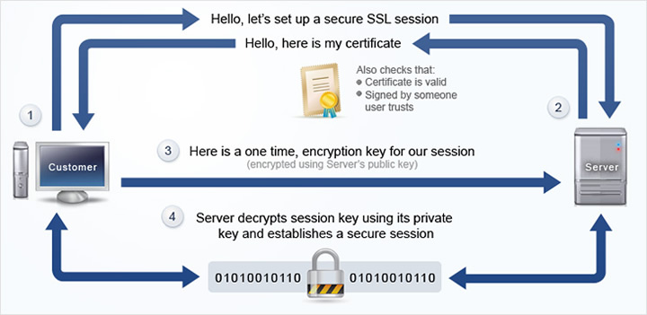

Slide 13









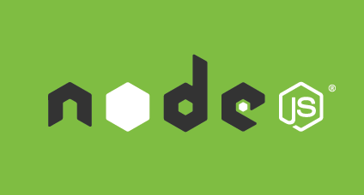

Client - Server

Slide 14



Client - Server

Slide 15
Il modello Web standard
Linguaggio di markup composto da elementi che contengono attributi. Questi elementi vengono utilizzati per identificare semanticamente i diversi tipi di contenuti.
I Cascading Style Sheets consentono di avere un controllo preciso della formattazione e del layout del documento. Funziona grazie ad un insieme di regole che consentono di selezionare gli elementi della pagina Html e definire le loro caratteristiche.
Javascript è un linguaggio di programmazione che consente di aggiungere dei comportamenti alla pagina web. Validazione degli input e animazioni tra le altre cose.

Slide 16

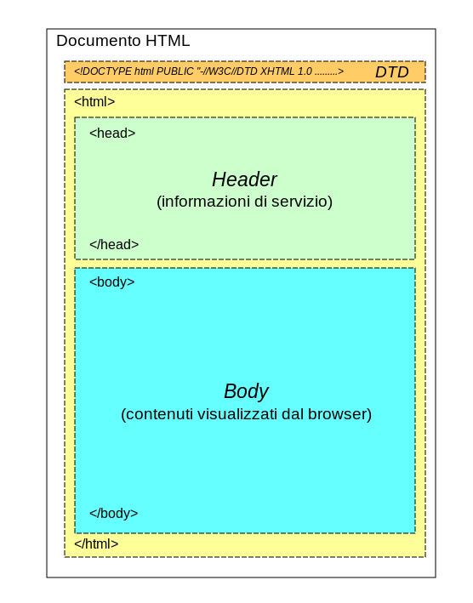
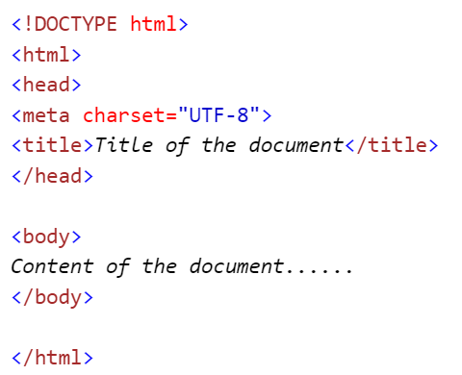
HyperText Markup Language (HTML)
Elementi
Tag
Attributi
Contenuto
Annidamento

Slide 17

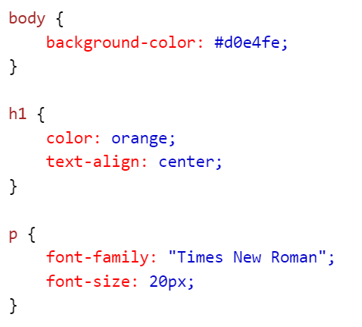
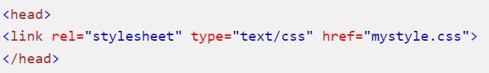
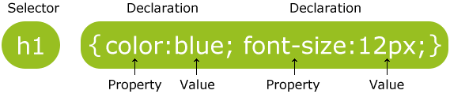
Cascading Style Sheet (CSS)

Slide 18
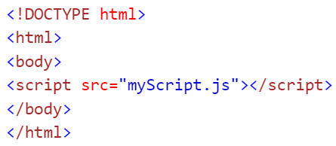
Javascript

Slide 19
Introduzione a ASP.NET MVC5
Le tecnologie Web di Microsoft
ASP.NET 4.5
ASP.NET MVC 5

Slide 20
Introduction to Microsoft Web Technologies
Develop
Host
Execute
Server-Side
Client-Side
WebMatrix
Visual Studio
Visual Studio Express
IIS
SQL Server
Windows Azure
SQL Database
ASP.NET
JavaScript
jQuery
AJAX
Notes:
This topic is intended as a high level overview of the web stack. Use it to orient students and provide quick definitions of all the technologies on the slide. Do not go into depth. If you spend more than the intended five minutes for this topic, you might not be able to complete all the topics in this module within the scheduled time. Tell students that subsequent topics and modules provide full details.
Developer Tools
Mention that WebMatrix 2 is the latest version of WebMatrix.
Orchard, Umbraco CMS, and WordPress are all popular web applications that provide content management facilities for small teams of users. Orchard and Umbraco are written in ASP.NET, while WordPress is written in PHP.
Visual Studio 2012 is the latest version of Visual Studio. Students will use Visual Studio 2012 throughout this course to build a web application.
Code Execution Technologies
IIS 8 is the latest version of this technology and is included in Windows Server 2012.
Most websites require a database to store information such as product databases, user information, and discussion topics. In the labs, for example, you will build an application that stores photos in a database.
Question: If you want to animate a page element, for example, by fading it in, would you write server-side or client-side code?
Answer: Client-side code. Server-side code cannot change the content of the page without a page reload, which would ruin the animation.
20486B
01: Exploring ASP.NET MVC 4

Slide 21

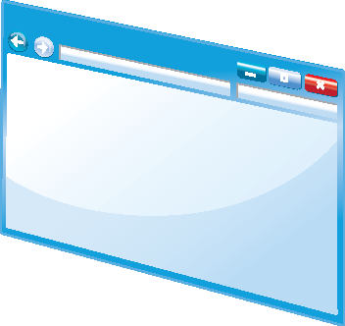


Overview of ASP.NET 4.5
Programming Models
Web Pages
Web Forms
MVC
ASP.NET API
Configuration
Authentication and Authorization
Caching
Compiling ASP.NET Code
ASP.NET 4.5
HTML
Pages
Notes:
Use this topic as an overview of ASP.NET to orient the students and to introduce key terminology. These will be covered in greater detail in subsequent lessons and modules.
Question: Which of the three programming models do you think provides the most control over the HTML and JavaScript code that is sent to the browser?
Answer: MVC and Web Pages provide a high level of control over the HTML and JavaScript code through the use of views.
20486B
01: Exploring ASP.NET MVC 4

Slide 22
Web Pages Applications
Web Matrix or Visual Studio
Code in .CSHTML files
Precise Control of HTML
<h2>Special Offers</h2>
<p>Get the best possible value on Northwind specialty
foods by taking advantage of these offers:</p>
@foreach (var item in offers) {
<div class="offer-card">
<div class="offer-picture">
@if (!String.IsNullOrEmpty(item.PhotoUrl)){
<img src="@Href(item.PhotoUrl) alt="@item.Title" />
}
</div>
</div>
}
Notes:
Web Pages is designed as a simple server-side programming model that is quick to learn. Ensure that you build a simple Web Pages application before you teach this topic so that you can highlight the differences between the programming models.
Question: Why should web developers need to take control of the URLs that appear in the Address bar when a visitor browses a Web Pages site?
Answer: User friendly URLs help users to navigate content and encourage them to share links to your site. They also assist in Search Engine Optimization.
20486B
01: Exploring ASP.NET MVC 4

Slide 23
Web Forms Applications
Visual Studio only
Code in .aspx files and code-behind files
Create a UI by dragging controls onto a page
Controls provide rich properties and events
Bind controls to data
Notes:
Some of your students may be familiar with ASP.NET Web Forms because they have been present since ASP.NET was introduced. If many students are familiar with Web Forms, you may like to structure this topic as a discussion of the key features of this programming model. This will enable you to assess students’ knowledge.
Question: Why should web developers be concerned about the markup and state information that ASP.NET Web Forms controls add to a rendered HTML page?
Answer: Markup and state information can, in certain circumstances, add significant amounts of extra HTML code to the rendered page. This can slow page load times.
20486B
01: Exploring ASP.NET MVC 4

Slide 24
MVC Applications
Visual Studio only
Models encapsulate objects and data
Views generate the user interface
Controllers interact with user actions
Code in .cshtml and .cs files
Precise control of HTML and URLs
Easy to use unit tests
Notes:
The MVC programming model should be new to the students for this course.
If you have many Web Forms developers among your students, you should emphasize the differences between the Web Forms and MVC programming models. For example, mention that there is no toolbox in MVC for building a user interface by dragging controls onto the page as there is in Web Forms. Also, point out that in MVC, each control does not have a set of server-side events that occur in response to user clicks. Instead, you respond by creating Controller actions.
Question: When a user makes a request for a particular product in your product catalog, which component receives the request first: a model, a controller, or a view?
Answer: A controller receives the request before a model or a view.
20486B
01: Exploring ASP.NET MVC 4

Slide 25
Shared ASP.NET Features
Configuration
Authentication
Membership and Roles
State Management
Caching
Notes:
Students will learn more about authentication, membership, roles, and authorization in MVC applications in Module 11.
Students will see how to store and retrieve state information in Module 12.
Students will see how to correctly configure the ASP.NET Output, Data, and HTTP caches in Module 9.
Question: Can you think of other facilities that all ASP.NET applications might need, regardless of the programming model they use?
Answer: Encrypted communication between browser and web server, enabled by the Secure Sockets Layer (SSL) protocol, is a good example of such a facility.
20486B
01: Exploring ASP.NET MVC 4

Slide 26
Introduction to ASP.NET MVC 4
Models, Views, and Controllers Demonstration: How to Explore an MVC Application New Features of ASP.NET MVC 4
Notes:
20486B
01: Exploring ASP.NET MVC 4

Slide 27

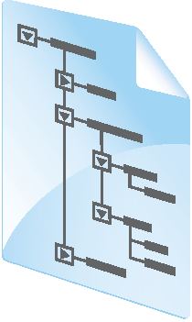


Models, Views, and Controllers
SQL
View
Model
Database
Controller
Web Server
HTTP
Browser
Notes:
Students will learn more about Entity Framework and data access in Module 2.
Students will learn more about the ASP.NET Routing Engine in Module 7.
Question: If you wanted to write some code that renders data from your products catalog into an HTML table, would you place that code in a model, a view, a controller, or a JavaScript function?
Answer: Since this is user interface code, you must place it in the view.
20486B
01: Exploring ASP.NET MVC 4

Slide 28
Progettare applicazioni web in ASP.NET MVC 5
Pianificare durante la fase di progettazione
Disegnare i modelli, i controller e le viste

Slide 29
Project Development Methodologies
Development Model | Description
Waterfall Model | Activities for building an application are performed sequentially in distinct phases with clear deliverables.
Iterative Development Model | An application is built iteratively in parts, by using working versions that are thoroughly tested, until it is finalized.
Prototype Model | Based on a few business requirements, a prototype is made. Feedback on the prototype is used as input to develop the final application.
Agile Development Model | An application is built in rapid cycles, integrating changing circumstances and requirements in the development process.
Extreme Programming | Begins with solving a few critical tasks. Developers test the simplified solution and obtain feedback from stakeholders to derive the detailed requirements, which evolve over the project life cycle.
Test-Driven Development | A test project is created and you can test changes to the code singly or as a group, throughout the project.
Unified Modeling Language | UML diagrams are used for planning and documenting purposes, across all project development models.
Notes:
Waterfall, iterative, and prototype development are older models and now less popular. You should devote most time to agile development, extreme programming, and test-driven development, and mention these as the most up-to-date models.
If you have worked on projects that used agile development, extreme programming, or TDD, use your real-world experience to illustrate the concepts in this topic. For example, describe a real-world component that you built and the unit tests that applied to it.
Mention that UML is not a project development methodology but is introduced here because it is common to all methodologies. Mention to students that UML diagrams will be shown later in the module.
Question: What aspects of agile software development and extreme programming might be of concern to customers? What aspects might reassure them?
Answer: Customers may be concerned that a complete specification is not in place when they place a purchase order for developing the application.
Customers will be reassured when developers continue to communicate with them throughout project development. They will also be reassured when they see functional applications early in the project, on which they can provide feedback.
20486B
02: Designing ASP.NET MVC 4 Web Applications

Slide 30
Gathering Requirements
Functional requirements describe how the application responds to users
Technical requirements describe the technical features of an application, such as availability, security, or performance
You can build functional requirements by using:
Usage scenarios
Use cases
Requirements modeling in agile
User stories in extreme programming
Sample UML Use Case Diagram
Notes:
The graphic on the slide is a simple UML use case diagram.
Before you teach this topic, you must read more details of requirement analysis methods, particularly with regard to how they apply to development methodologies such as Agile and Extreme Programming. The following links provide a starting point:
http://go.microsoft.com/fwlink/?LinkID=288946&clcid=0x409
http://go.microsoft.com/fwlink/?LinkID=288947&clcid=0x409
http://go.microsoft.com/fwlink/?LinkID=288948&clcid=0x409
Question: If a customer asks you to ensure 95% availability, is this a functional requirement or a technical requirement?
Answer: If a customer asks you to ensure 95% availability, it is a technical requirement.
20486B
02: Designing ASP.NET MVC 4 Web Applications

Slide 31
Planning the Database Design
Logical Modeling
Physical Database Structure
Working with DBAs
Database Design in Agile and Extreme Programming
Notes:
The audience of this course has experience in creating databases for simple web applications. The database objects that you describe should refresh their memory or fill in gaps in their knowledge. However, a complete description of all the objects in Microsoft SQL Server 2012 or other database engines is beyond the scope of this ASP.NET course, and you cannot train the students to be DBAs. The intention is to provide a simple introduction to database structures.
Question: You want to implement a shopping cart in your web application. How many logical data models are required? How many database tables are required?
Answer: Answers may vary. Logical models may include a Shopping Cart, a Customer, a Product, and a Shipping Method. Students might suggest others. Database tables may include ShoppingCarts, ShoppingCartEntries, Products, ShippingMethods, Customers, and others.
20486B
02: Designing ASP.NET MVC 4 Web Applications

Slide 32
Planning for Distributed Applications
Layers
Presentation
Business Logic
Data Access
Database
Communication
Security
Browser
Web
Server
Presentation
Middle
Tier
Server
Business Logic
Data Access
Database
Server
Notes:
The subject of distributed applications, their architecture, and the protocols and technologies underlying them is huge and cannot be treated in full here. Your aim should be to introduce the concepts and technologies like WCF. If students demonstrate an interest in building distributed architectures for their web application, refer them to Course 20487A: Developing Windows Azure and Web Services.
Question: What are the advantages of writing middle-tier components as WCF services and not web services?
Answer: You can host WCF services on either Internet Information Server (IIS) or WAS. Web services can only be hosted on IIS.
20486B
02: Designing ASP.NET MVC 4 Web Applications

Slide 33
Planning State Management
Client-side locations to store state data:
Cookies
Query Strings
Server-side locations to store state data:
TempData
Application State
Session State
Profile Properties
Database Tables
Notes:
In Module 4, you will describe to the students the ViewBag and ViewData objects. Do not introduce them here because the ViewBag object and ViewData object cannot be used to store state information. They are destroyed for a new page request. Those objects are used to store information between the controller, view, and partial views that render a single HTML page.
You might like to present some state management scenarios from your own experience of building real-world MVC web applications, and discuss with the students the most appropriate location to use.
If you have any ASP.NET Web Forms developers in the class, emphasize that View State, Control State, and Hidden Fields are not available. You should discourage them from developing similar solutions for MVC pages because of the extra resources such approaches use to store data in HTML pages.
Question: You show the visitors of your website a choice of countries. When they pick a state, you want to redirect them to a page that shows a map of that state. You will not use the name of the chosen country that the user selected after this. Which location should you use to store the name of the chosen country?
Answer: The TempData store is ideal for storing the country because you only use it on the next page. Alternatively, you can use a query string value or a form field with the POST method to pass the country value.
20486B
02: Designing ASP.NET MVC 4 Web Applications

Slide 34
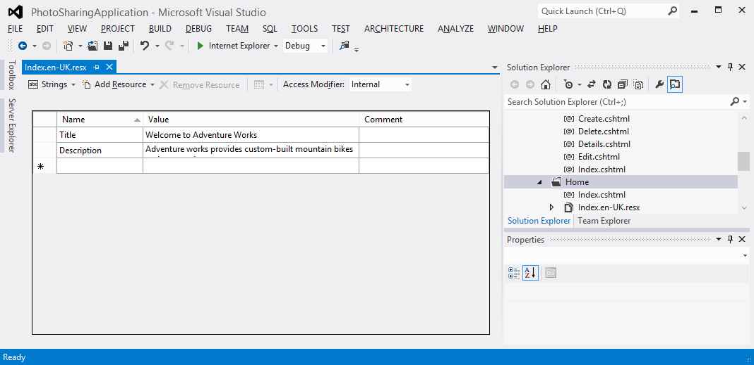
Planning Globalization and Localization
You can use the internationally-recognized set of language codes available in browsers to present content customized to suit a user’s language or region
You can use resource files to provide a localized response suitable to a user’s culture
You can use separate views to suit each language code
Notes:
Question: Which language do you consider would be appropriate to specify in the default resource file?
Answer: The language that you choose for the default resource file should be the one that is spoken by the largest proportion of your visitors. Because Internet is a global system, the language is usually English because it is the language spoken by the largest number of people, worldwide.
20486B
02: Designing ASP.NET MVC 4 Web Applications

Slide 35
Designing Models
Model Classes and Properties
Domain Model and Logical Data Model Diagrams
Relationships and Aggregates
Entity Framework
Design in Agile and Extreme Programming
Notes:
Tell the students that they will use Entity Framework in the code-first mode in the lab.
20486B
02: Designing ASP.NET MVC 4 Web Applications

Slide 36
Designing Controllers
Controller | Action
Photo | AddPhoto (GET)
 | AddPhoto (POST)
 | DisplayGallery (GET)
User | Logon (GET)
 | Logon (POST)
Identify Controllers and Actions
Design in Agile and Extreme Programming
Notes:
Because the students have little experience of coding controllers and actions for themselves, they may find this topic difficult. Reassure them that this task becomes easier when they perform some hands-on exercises, which they will do in Module 4. They will architect a few controllers in Module 4.
20486B
02: Designing ASP.NET MVC 4 Web Applications

Slide 37
Designing Views
Views, Templates, and Partial Views
Wire-Framing
Design in Agile and Extreme-Programming
Notes:
The graphic on the slide is a simple wireframe diagram that resembles the photo details view in the photo sharing application that the students will build in the labs.
20486B
02: Designing ASP.NET MVC 4 Web Applications

Slide 38
Sviluppare i modelli di ASP.NET MVC 5
Creare i modelli
Lavorare con i dati

Slide 39
Developing Models
public class Photo
{
public int PhotoID { get; set; }
public string Title { get; set; }
public byte[] PhotoFile { get; set; }
public string Description { get; set; }
public DateTime CreatedDate { get; set; }
public string Owner { get; set; }
public virtual ICollection<Comment> Comments { get; set; }
}
Notes:
The slide shows a simple Logical Data Model (LDM) diagram with two model classes: Photo and Comment. Each class has a simple set of properties and there is a one-to-many relationship between the classes; that is, each photo can have zero or more comments.
The Unified Modeling Language (UML) diagram on the slide shows both the Photo and Comment model classes and the relationship between them. The code on the slide shows only the Photo class. Point out to the students that the Photo class includes a collection of comment objects—this implements the one-to-many relationship between Photos and Comments.
20486B
03: Developing ASP.NET MVC 4 Models

Slide 40
Developing Models (Continued)
public class Comment {
public int CommentID { get; set; }
public int PhotoID { get; set; }
public string UserName { get; set; }
public string Subject { get; set; }
public string Body { get; set; }
public virtual Photo Photo { get; set; }
}
Comment newComment = new Comment();
newComment.UserName = User.Identity.Name;
newComment.Subject = "This is an example comment";
return View("Display", newComment);
Notes:
This additional slide shows a second model class example for comments and how to instantiate a model class in a controller action.
20486B
03: Developing ASP.NET MVC 4 Models

Slide 41
Using Display and Edit Data Annotations on Properties
public class Photo
{
public int PhotoID { get; set; }
public string Title { get; set; }
[DisplayName("Picture")]
public byte[] PhotoFile { get; set; }
[DataType(DataType.MultilineText)]
public string Description { get; set; }
[DataType(DataType.DateTime)]
[DisplayName("Created Date")]
[DisplayFormat(DataFormatString = "{0:MM/dd/yy}", ApplyFormatInEditMode = true)]
public DateTime CreatedDate { get; set; }
public string UserName { get; set; }
public virtual ICollection<Comment> Comments { get; set; }
}
Notes:
The display and edit data annotations in the slide are enclosed in square brackets. Highlight these annotations to the students and ensure that they can distinguish them from properties and other code.
Other data annotations, such as validation annotations, are discussed later in the course.
Question: In the code on the slide, how can you recognize the display and edit annotations and distinguish them from property code?
Answer: The display and edit annotations are enclosed in square brackets.
20486B
03: Developing ASP.NET MVC 4 Models

Slide 42
Validating User Input with Data Annotations
public class Person
{
public int PersonID { get; set; }
[Required(ErrorMessage="Please enter a name.")]
public string Name { get; set; }
[Range(0, 400)]
public int Height { get; set; }
[Required]
[RegularExpression(".+\\@.+\\..+")]
public string EmailAddress { get; set; }
}
Notes:
Question: You want to ensure that users enter a password that is longer than six characters. How should you do this by using a validation data annotation?
Answer: You can use the StringLength validation data annotation to specify this minimum length.
20486B
03: Developing ASP.NET MVC 4 Models

Slide 43
What Are Model Binders?
The Default Controller Action Invoker uses model binders to determine how parameters are passed to actions
The Default Model Binder passes parameters by using the following logic:
The binder examines the definition of the action that it must pass parameters to
The binder searches for values in the request that can be passed as parameters
Notes:
This topic explains how model binding and action invocation work in the default configuration for MVC 4 web applications. Later in the course, you will show students how to alter this arrangement by creating custom model binders and custom action invokers. You will also explain why web application architects may want to modify the default behavior. However, at this stage, concentrate on a clear explanation of the default classes.
20486B
03: Developing ASP.NET MVC 4 Models

Slide 44
Model Extensibility
Custom validation data annotations can be used to indicate to MVC how to validate the data a user enters in a form or passes in query strings
There are four built-in validation attributes:
Required
Range
StringLength
RegularExpression
A custom model binder ensures that it identifies parameters in a request and passes all of them to the right parameters on the action
Notes:
Until Module 5, students will not see validation messages displayed because they are displayed by views. Custom model binders are an advanced topic, and because the default model binder is so flexible, it is unusual to create a custom model binder. Some students may not use this technique in any of their future projects.
Question: You want to ensure that when a user types a value into the Car Model Number box when adding a new car to the website, the text entered is not already used by another car in the database. Would you use a custom validation data annotation or a custom model binder for this check?
Answer: You would use a custom validation data annotation for this check.
20486B
03: Developing ASP.NET MVC 4 Models

